Slide 1
Swin Transformer: Hierachical Vision Transformer using Shifted Windows (Ze Liu, Yutong Lin, Yue Cao, Han Hu, Yixuan Wei, Zheng Zhang, Stephen Lin and Baining Guo) RAMI LAB. Sang-Hyun KIM

Slide 2
Contents
Introduction
Swin Transformer
Architecture
Swin transformer blocks
Shifted window based self-attention
Cyclic shift
Variants
Experiments
Conclusions
Q & A

Slide 3
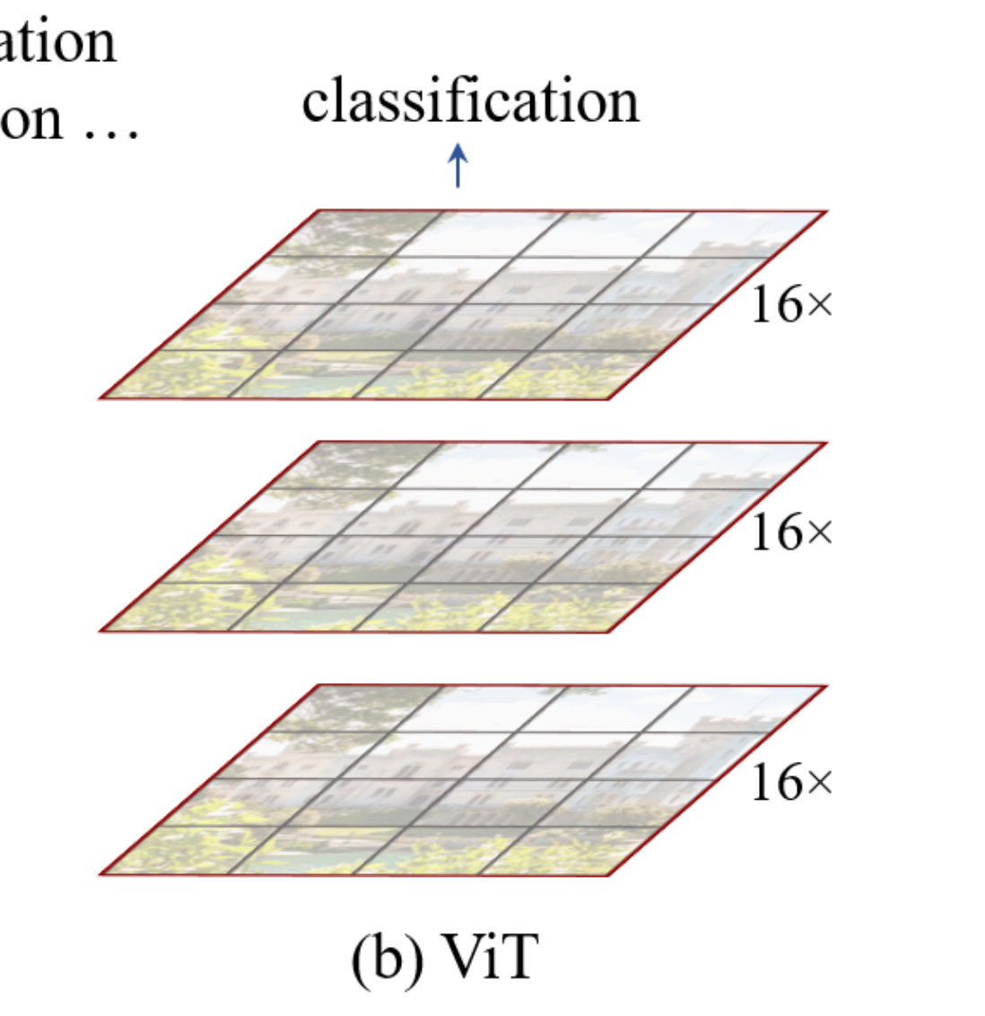
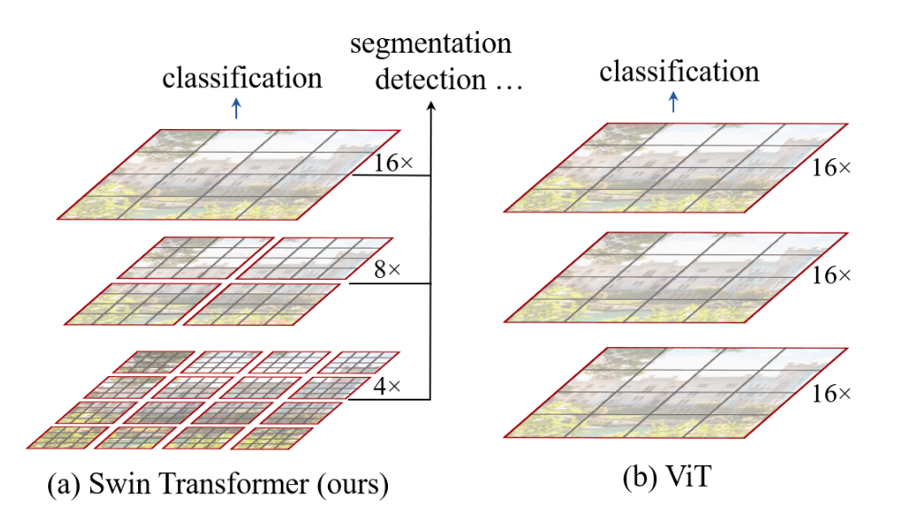
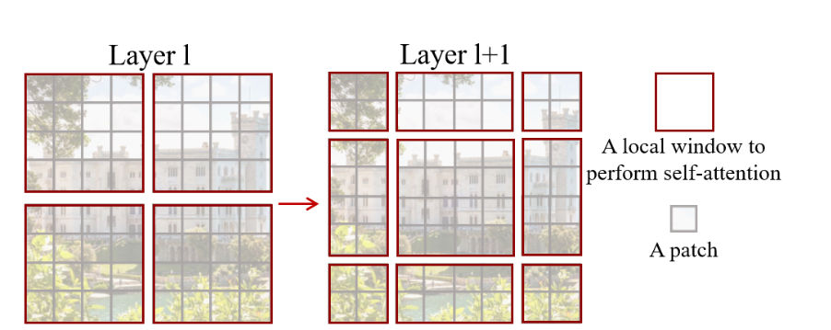
Introduction
Swin Transformer
Swin Transformer is new vision Transformer with hierarchical feature maps and shifted windows.
Hierarchical feature maps
Shifted window

Slide 4
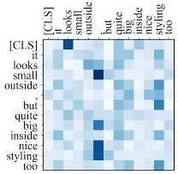
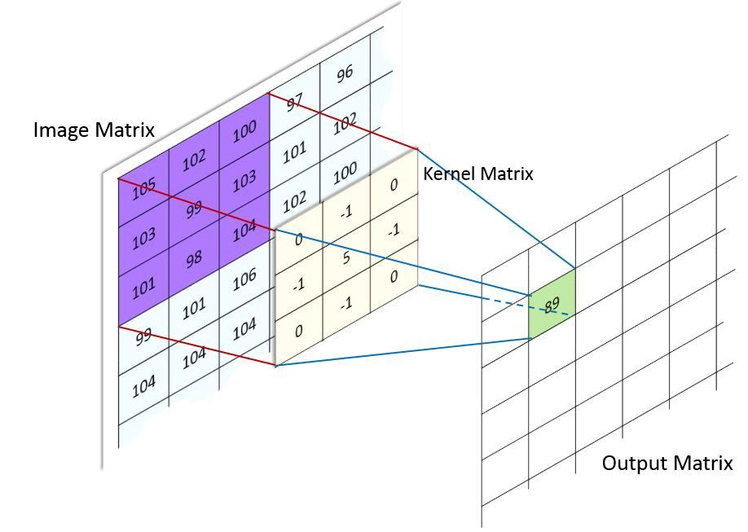
Transformer
Attention can simultaneously extract all the information we need from the input and its inter-relation.
CNNs are much more localized. It does not have the spatial information necessary for many tasks like instance recognition because convolutions don't consider distanced-pixels relations.
Attention
CNN

Slide 5

Self-attention
Self-attention could be seen as a measurement of a specific word's effect on all other words of the same sentence.
This same process can be applied to images calculating the attention of patches of the images and their relations to each other.
A cat sleeping on couch
A cat sleeping on couch

Slide 6
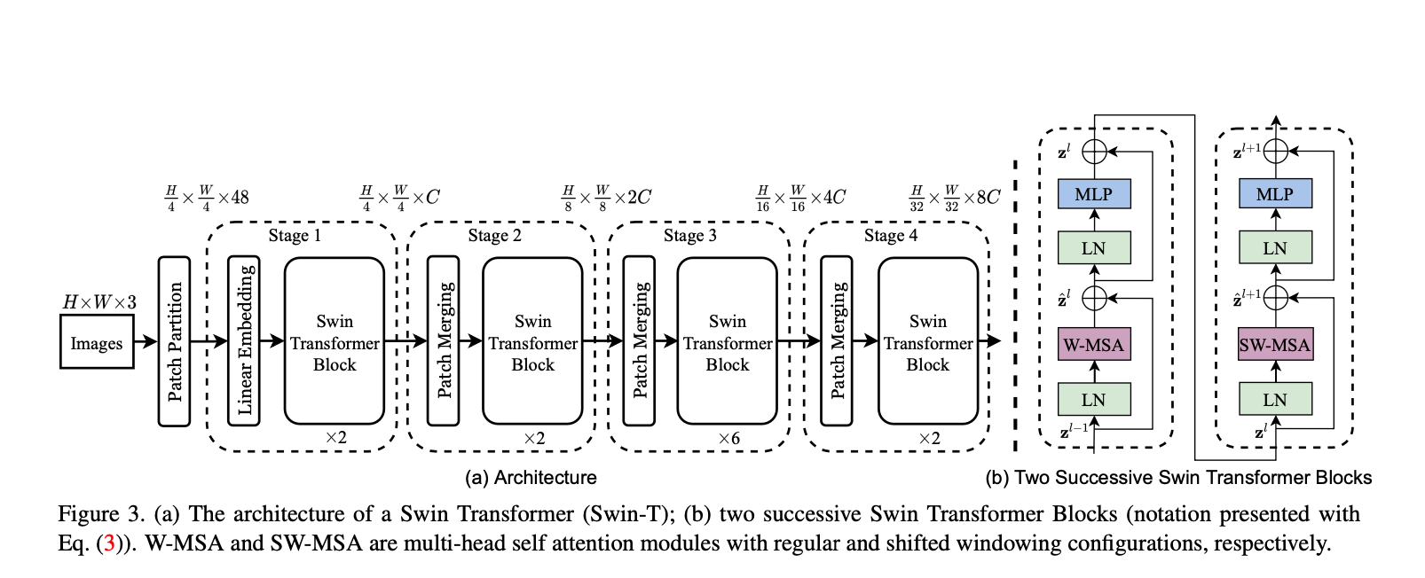
Overall Architecture

Slide 7
Overall Architecture

Slide 8
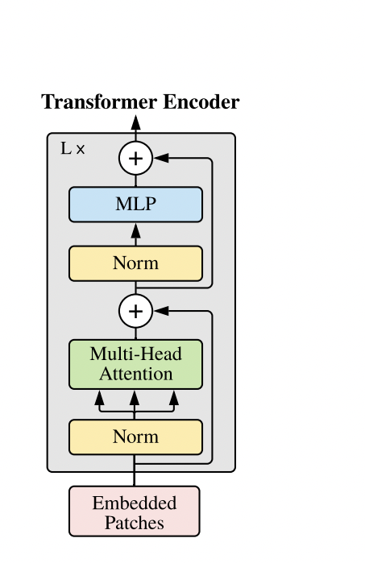
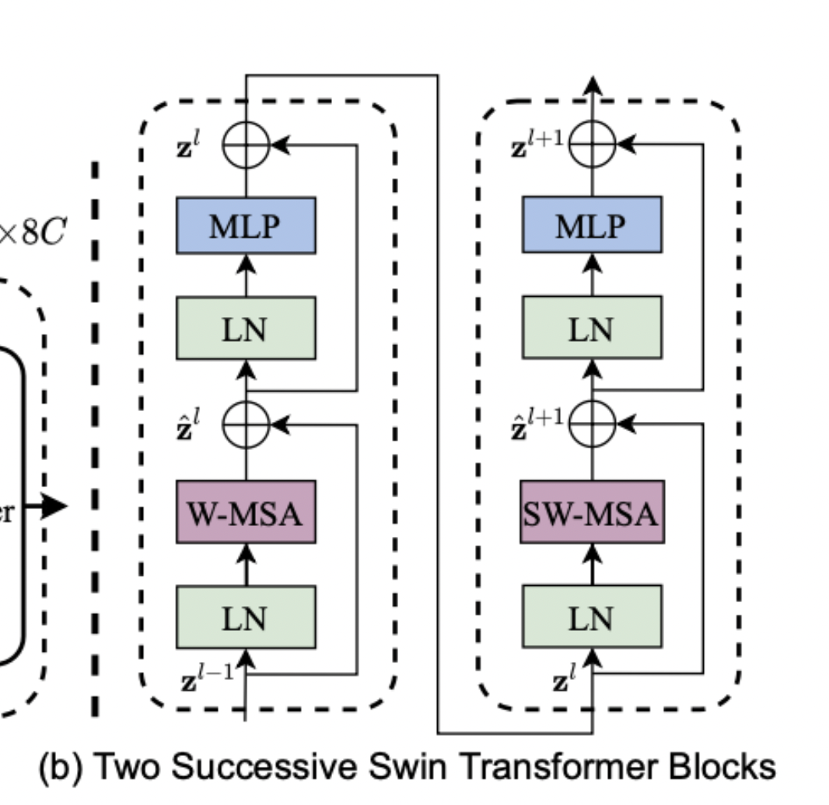
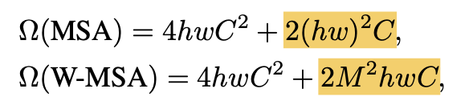
ViT (Vision Transformer)
ViT directly applies a Transformer architecture on non-overlapping image patches.
It has the quadratic increase in complexity with image size. Swin transformer block modifies the multi-header self-attention.

Slide 9
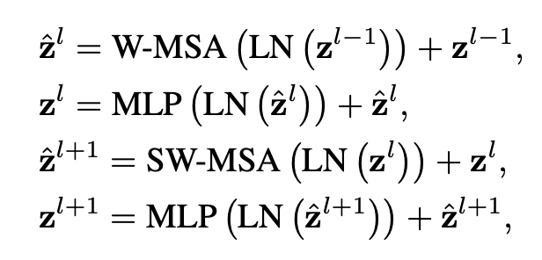
Swin Transformer Blocks
W-MSA
The input image is divided into four windows and compute attention for patches within the window.
SW-MSA
The approach introduces connections between neighboring non-overlapping windows in the previous layer.

Slide 10
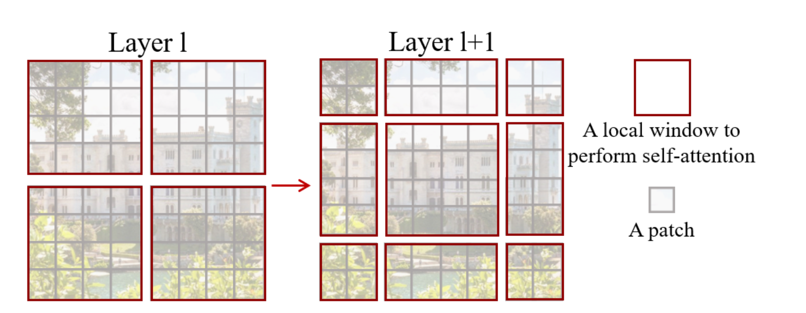
Shifted Window based Self-Attention
Self-attention is applied on each patch, here referred to as windows. In layer l (left), a regular window partitioning scheme is adopted, and self-attention is computed within each window.
Then, the windows are shifted, resulting in a new window configuration to apply self-attention again. This allows the creation of connections between windows while maintaining the computation efficiency of this windowed architecture.

Slide 11
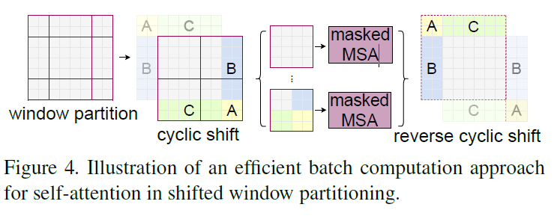
Cyclic-Shift
The paper propose an efficient batch computation approach by cyclic-shifting toward the top-left direction
After this shift, a batched window may be composed of several sub-windows that are not adjacent in the feature map, so a masking mechanism is employed to limit self-attention computation to within each sub-window.

Slide 12
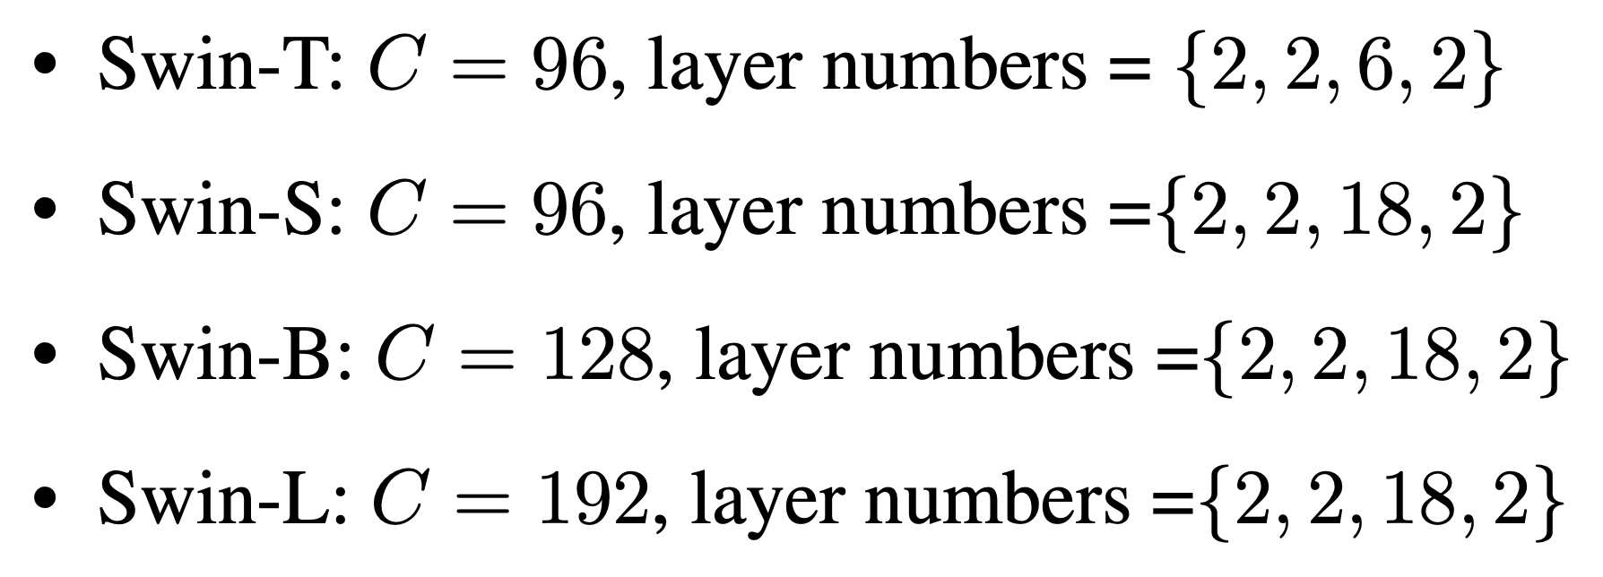
Variants
The paper also introduce Swin-T, Swin-S and Swin-L, which are versions of about 0.25x, 0.5x and 2x the model size and computational complexity, respectively.
The value of c is from 96 to 128 and 192. The number of blocks is also changed at each stage from 6 to 18 or keeping them to 2

Slide 13
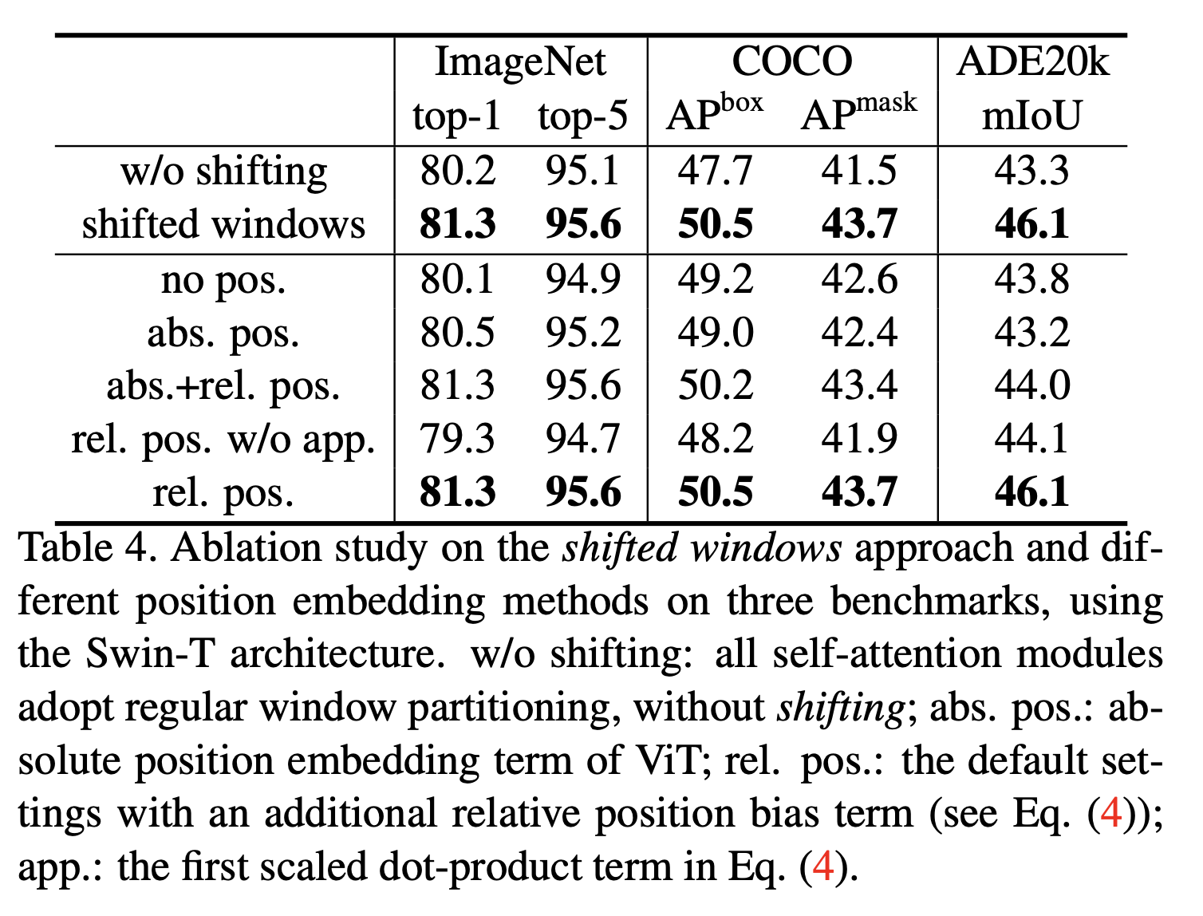
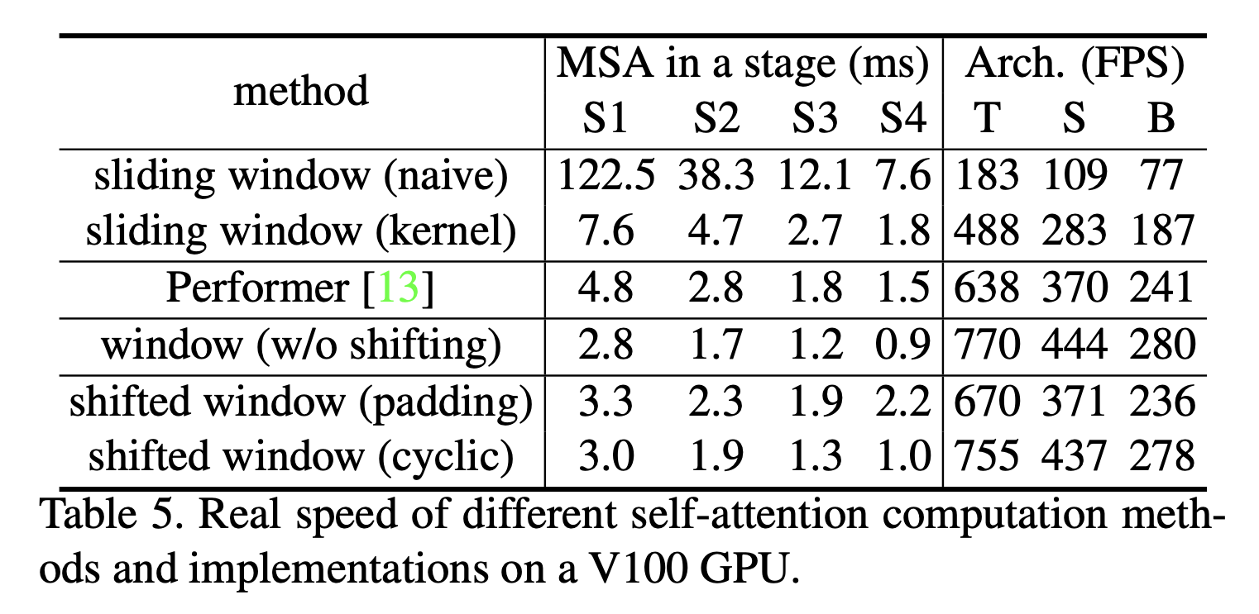
Ablation Study
The paper show the results of ablation study on shifted window approach. Speed of padding and cyclic method is also compared.

Slide 14
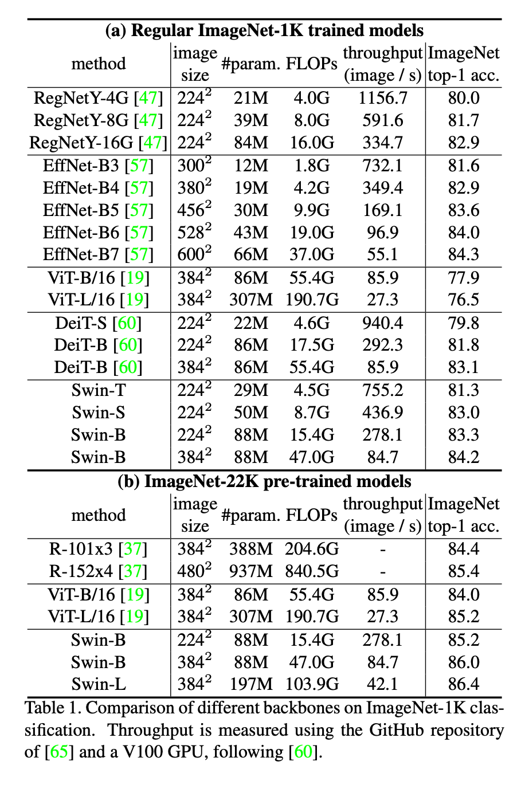
Classification Results

Slide 15
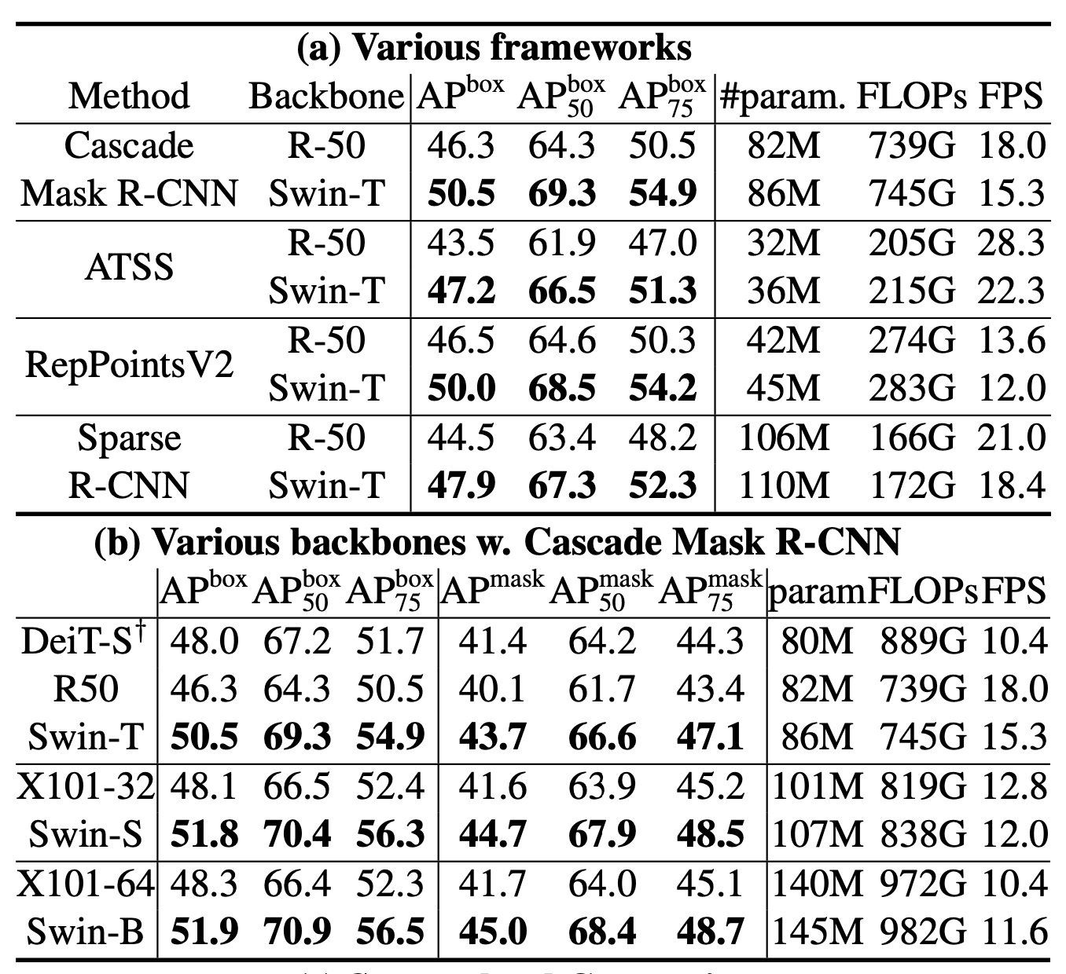
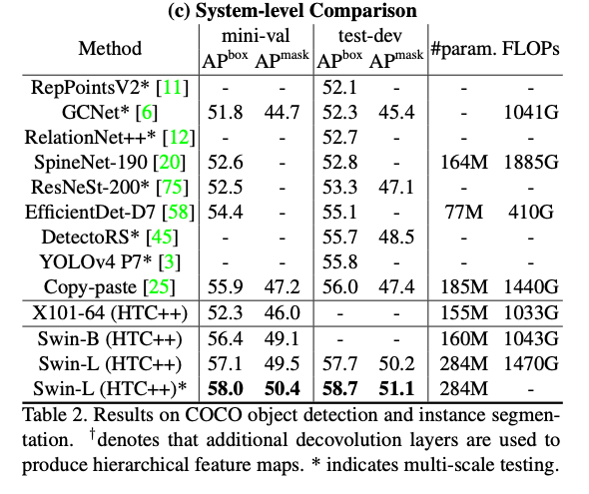
Detection Results

Slide 16
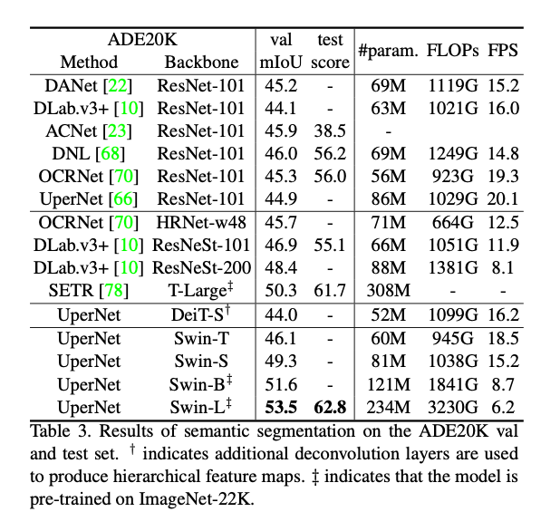
Semantic Segmentation Results

Slide 17
Conclusion
This paper presents Swin Transformer, a new vision Transformer which produces a hierarchical feature representation and has linear computational complexity with respect to input image size.
As a key element of Swin Transformer, the shifted window based self-attention is shown to be effective and efficient on vision problems.
Using a similar architecture for both NLP and computer vision could significantly accelerate the research process.
A cat sleeping on couch
A cat sleeping on couch

Slide 18
Q & A

Slide 19
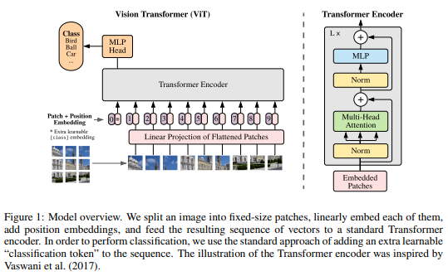
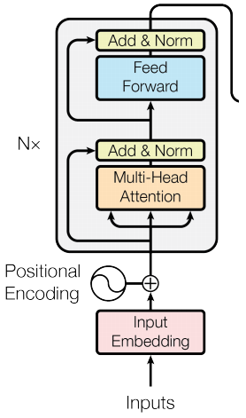
Related Work
ViT (Vision Transformer)
Model overview
4
vs
2
1
3
Vanilla transforemer encoder

